Slide 1



The Basics of
Ashley Anderson
PyLadies 16th July 2018
@ash_bioinf a-anderson

Slide 2
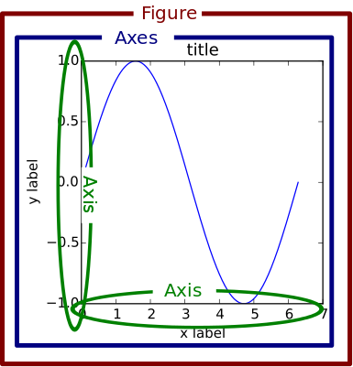
Matplotlib Object Hierarchy
Figure
The outermost container
Axes
An individual graph
Axis
x-axis and y-axis
Smaller objects:
tick marks
lines
legends
Notes:
Figure object = outermost container for a matplotlib graphic
Axes = NOT plural of axis → individual plot
Other smaller objects like the x&y axis, tick marks, legends, etc

Slide 3
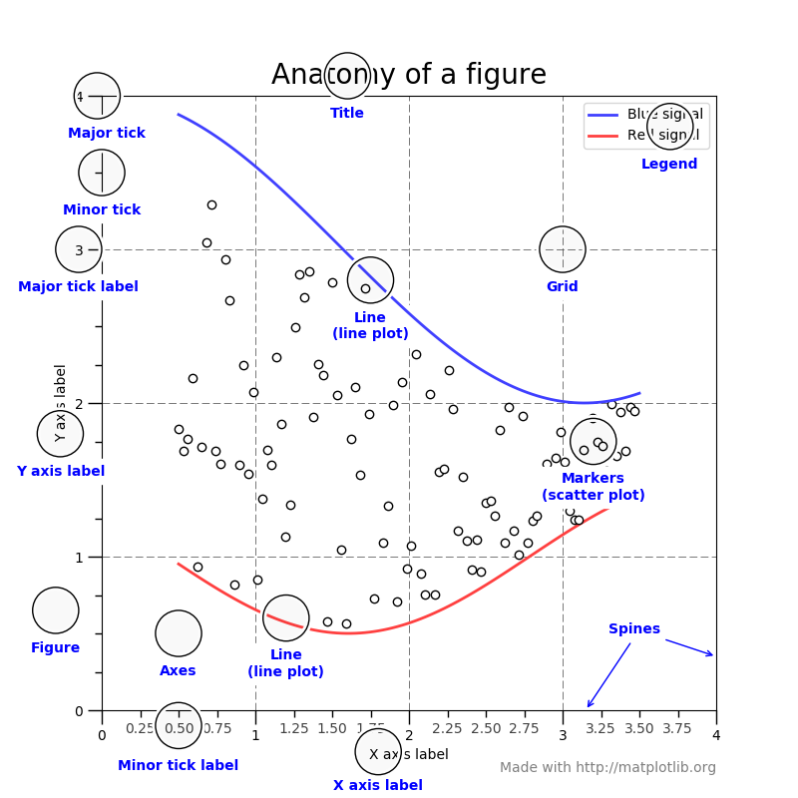

Slide 4
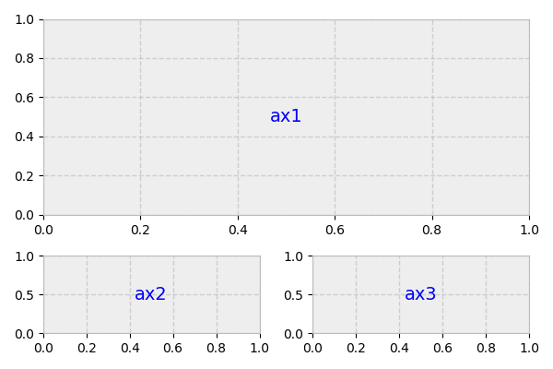
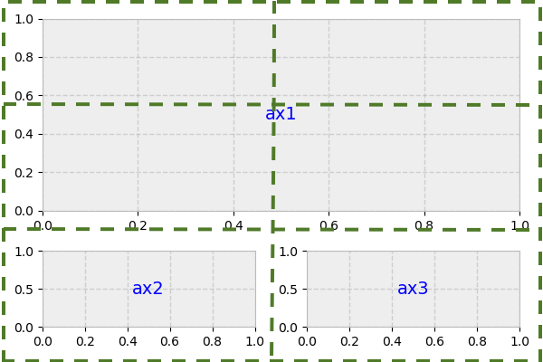
plt.subplots() & subplot2grid()
https://matplotlib.org/users/gridspec.html
Notes:
subplot2grid is a helper function that lets subplots occupy multiple cells

Slide 5
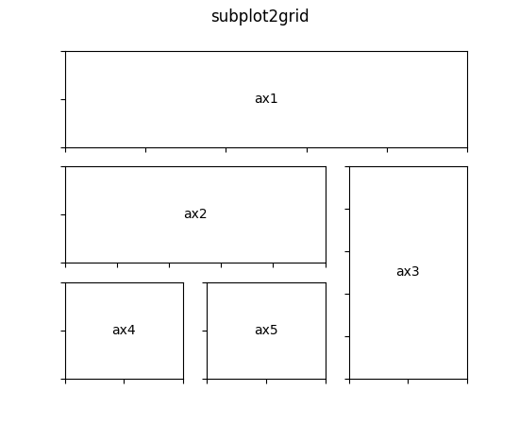
Gridspec
gridspec states the location of the subplot in the figure
GridSpec specifies the geometry of the grid in which a subplot will be placed
subplot2grid is a helper function that lets subplots occupy multiple cells
https://matplotlib.org/users/gridspec.html
Notes:
Gridspec is a module that specifies the location of the subplot in the figure

Slide 6
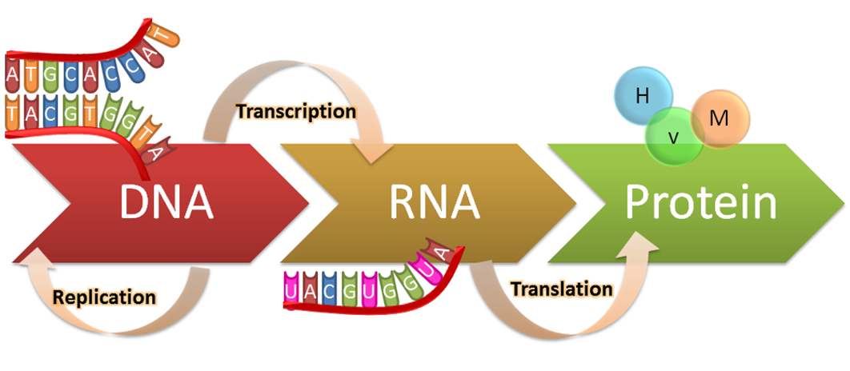
The ‘Central Dogma’
https://bit.ly/2IU4wi2

Slide 7
The Basics of
Ashley Anderson
PyLadies 16th July 2018
@ash_bioinf a-anderson

